Slide 1
Telecomm Network Management
Module 1 :Overview of Network Management
Case histories on network, system and service management, challenges of IT managers
Network Management: Goals, organization and functions
Network management architecture and organization network management perspectives
Case histories on network, system and service management, challenges of IT managers
Network Management is more than just managing the network. It is referred to as Operations, Adminstration, Maintenance and Provisioning (OAMP). Network management and its complimentary functions of system management and application management are all means to the end of service management in providing the subscriber or customer quality of service. As one IT manager commented, the configuartion and use of NMS formalizes what a network adminstrator would have otherwise done.
Case History 1: Importance of Topology(“ Case of the Footprint”)
A stable corporate network consisting of several minicomputers and about 100 desktop workstations and personal computers suddenly started “crashing” frequently (a legacy network example). How often have we heard a network coming down without any apparent reasons? Here is how one vice president of information Systems describes an incident.
Part of the network went down in the engineering area one morning. Since there were a whole series of users and at that time we were not using a STAR (hub) topology, but rather the old -fashioned serial topology( where all the users were daisy chained to the coax), we suspected a break in the chain, probably at a transreceiver tap. Lacking sophisticated NMS tools, information System personnel started walking the hall ways asking the users if anyone had just been doing anything out of the ordinary, which might have broken the chain and caused the problem.
The guys came back and reported that no one had said that they had “done anything” so I (VP) started back down the halls with the guys and peeked into each office. Finally, I stopped and said “Let's look up in the ceiling here.” Sure enough, we found a transceiver that someone had been fooling with and that was not properly connected, which had caused the break. Once connected, the network segment came back up.
The guys asked” Why did you say _try here?” particularly since the engineer in that office claimed ignorance. I camly pointed to a dusty image of a sneaker footprint on the engineer's desk and the ceiling tile that was ajar above the desk and said - “ you need to use all the diagnostic tools at your disposal!”
Case history 2 : Centrally Managed Network Issues
There are numerous war stories that we can describe relating to heavy load on a NMS managing the network and network elements. An integrated netwok management system (INMS) was integrating alarms from multiple element mangement systems (EMSs) in a service provider network. Each EMS manges a domain of network elements and passes the relevant events to the INMS as shown in Fig 1.

Slide 2
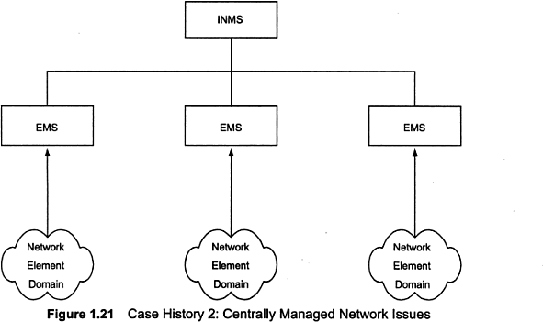
Telecomm Network Management
The service provider is able to monitor in its centrally located NOC faults occuring in its global network. Let us consider a simple real -world situation in which a few EMSs were integrated into an INMS and the alarm occurrence time in the INMS was at variance with the individual EMSs.
Each EMS records and displays the receipt time of the alarm. The same is transmitted to the INMS. It was observed that the indication of the time at which the alarm occurred was significantly different in INMS from that indicated in the EMSs that were sending alarms. The alarm occurrence time was considerably delayed, sometimes by hours, in INMS. The challenge in a centrally manged network is to find the root cause of the problem. Is it network delay? Is the delay due to excessive number of events? Its Is it due to input/ output (I/O) limitation of the input port of the INMS? Is it due to I/O output port of the EMS? Is it in the software of either EMS or INMS or both? If it is in the INMS software, should the filtering of unnecessary events at the input take care of the problem? The answers to most of these questions were affirmative for each , but to a varying degree in each case. The predominant cause is the stress on NMSs although it can be traced sometimes to network elements in the various domains. Transmission of un necessary alarms also causes a stress on the network and networks have gone down due to uncontrolled generations of network management messages.
1.1.3 Transaction Delays in Client -Server Network
In the current national and global enterprises organizations, applications servers serve thousands of clients over international networks. In a study of banking industry, transaction delays were measured and analyzed to determine the root cause of the delay as reported by tellers of branches. The propagation time of individual transactions was monitored as they traversed throught the LAN

Slide 3
Telecomm Network Management
networks and servers of the branches, through the WAN, and centrally processed by an application server. Some of the transactions were discovered to time out due to long transaction delays. Study results identified the source of the problems to be gateways and applications, and appropriate actions were initiated to resolve the problem. This case illustrates the need for management of end- to-end communication and the influence of network components, applications and client- server architecture in the network.
Service Impact in End- to- End Service of Customers
End to end communication is further illustrated by the need to proactively identify the service of the customers affected by a network element failure. This is illustrated by the following case. In an optical fiber transpoert network using TDM SDH network elements that carries thousands of channels, the failure of a single components affects services of hundreds of customers. An end to end communication breakdown is to be traced to the failure of a single or multiple network elements by root cause analysis and dynamically determine all clients whose services are impacted. The service provider detects the problem even before customer complaints are received and informs the customers that the problem is already being addressed to restore service as soon as possible.
Some Common Network problems
The most common and serious problems in network are connectivity failures and are handled under the category of fault mangement. Fault is generally interpreted as failures in accessing networks and systems by users. Network failure is caused more often by a node failure than failure of passive links. Even node failures are more often limited to specific interface failures. When this happens, all downstream systems from that interface are inaccessible. Such failures are associated with failures of the network interface card.
Node failures manifest as connectivity failures to the users. There are networking tools available to the manager to localize the fault.
Another cause of network connectivity failure is procedural, but very common. Network connectivity is based on the IP address, which is a logical address assigned by the network administrator. The IP address is uniquely associated with a physical MAC address of the network component. However, mistakes are made in assigning duplicate IP address, especially in an enterprise environment with multiple system adminstrators.
A host or system interface problem in a shared medium can bring the entire segment down, sometimes intermittently. This could be a nightmare for the network manger to isolate without causing interruption in service. A network manger uses intuitive knowledge to look for patterns such as change in configuration, addition of new equipment of facility, etc in resolving such problems.
Intermittent problems could also occur due to traffic overlaod causing packet loss. Sometimes the management system may indicate failures, when in actually data traffic is flowing normally. Performance monitoring tools could be useful in tracking such problems.

Slide 4
Telecomm Network Management
Power hits could reset network component configuration, causing network failures. The network has a permanent configuration (default) and a dynamic configuration (run-time) and thus a power hit could change the configuration.
Finally, there is the non-problem , which really means that the cause of failure is a mystery. There is nothing else that a network manager could do except turn the system off and then go.
Performance problem could also manifest as network delay and is more an annoyance to the network manger, who needs to separate network delay from the application program or application processes delay. Then the network manger has to convince the user and then the person responsible for the application to rectify the situation.
With ever increasing size of the network and conncetivity to the internet, security violation in network management is a frequently encountered problem.
1.1.6 Challenges of IT Managers
Managing a corporate network is becoming harder as it becomes larger and more complex. When we talk about network management, it includes not only components that transport information in the network, but also systems that generate traffic in the network. What use is a computer network if there are no system in the network to provide service to users? The systems could be hosts, database servers, file servers, or mail servers. In the client server environment, network control is no longer centralized, but distributed. Computer and telecommunication networks are merging fast into converged network with common modes and media of transportation and distribution. As in the case of broadband networks, the IT manager needs to maintain both types of networks. Thus, the data communications manager functions and telecommunciataion manger functions have been merged to that of the IT manager.
With explosion of information storage and transfer in the modern information era, management of information is also the responsibility of the IT manager, with the title of CIO, Chief Information Officer. For example, the IT manager needs to worry in detail about who can access the information and what information the they can access, i.e., authentication and authorization issues of security mangement. The corporate network needs to be secured for privacy and content, using firewalls and encryption. Technology is moving fast and corporate growth is so enormous, that a CIO has to keep up with new technologies and the responsibility for financial investment that the corporation commits to. This amounts to millions of the dollars, and the success of failures of making the right guess-- not choice ---- could make or break the CIO's job.
Perspective of Network Managers
Even use of the best NMS does not solve the problems associated with the building and maintaining a networkm but it is a ncessary tool. Thus, learnining network mangement involves more than just understanding Networks and network management protocol.

Slide 5
Telecomm Network Management
General
People expect a network to function like a telephone network.
Reliability in a data network as ina telephone in unrealizable. The telephone network was monopolistic and had expensive redundancy. The data network is adhoc, decentalized , has loosely specified interfaces, and has dynamic routing. Thus , it is a lot more flexible than the telephone network tough less reliable.
Designing, deploying and managing networks that can handle real time and non real time data.
Integration of multivendoe and multitechnology equipment and their network management systems.
What are your top challenging activities in managing the network?
Rapid advance of technology
Problem analysis – needs human intuition and skill besides sophisticated management tools
Anticipate customer demands
Acquire and retain human resources
Manage client – server environment in converged networks
Networking with emerging technology necessitates the need for continuing education
Collaborative research between academic institutions and industry
Maintain reliability, that is, make changes, upgrades, etc., without disrupting the network and impacting business
Diagnose problems or outages in a non-disruptive manner (without impacting other users on the network)
Estimate the value of a technology transition. For example, should one transition over to accommodate the increasing numner of Ip addresses with IPv6 or continue with IPv4 with Network Address Translation (NAT) as a hierarchical addressing schemes?
2. Which elements of managing your network require most of your time? What percentage of time do you spend on maintenance compared to growth?
A 30 - 80% growth, 20-70% maintenance based on organiztion
Configuring the management system itself takes most of the time
Expanding the network
Gathering and analyzing statistics for upper mangement review to conduct business.
3. How did you or would you manage your network without an NMS?
Reactively, not proactively; firefighting
Troubleshooting tools eg., sniffer, ping etc.
Home -grown systems using open source , eg., Multi Router Traffic Grapher (MRTG)
Rely on consultant advice and technical information for growth decisions

Slide 6
Telecomm Network Management
4. Do you need an NMS? Why?
For proactive management of network
Verify customer configuration
Diagnoise problem
Provide statistics on performance
Help remove bottlenecks
NMS formalizes the manual practice of network management
NMS products reflect the company's practice that develops them
To see the trend in growth
5. What problems would you expect the NMS to resolve, and how?
Enhance customer satisfaction by meting the Service Level Agreement (SLA)
Save time and people resource and thus enhance productivity
Turn around shorter for reolution of problems
Gather statistics and predict trends for planning purposes
Document events
Troubleshooting
Remove constraints and bottlenecks
Fault isolation
Expect the NMS to do a root cause analysis and pinpoint failures

Slide 7
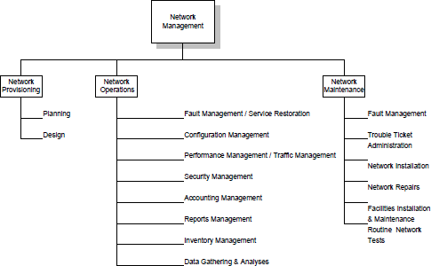
Telecomm Network Management
1.2 Network Management: Goals, organization and functions
Network Management can be defined as Operations, Administration, Maintenance and Provisioning (OAMP) of network and services. The Operation group is concerned with daily operations in providing network services. The Network Adminstration is concerned with establishing and adminstering overall goals, policies , and procedures of network management. The Installation and Maintenance (I &M) group handles functions that includes both installation and repairs of facilities and equipments. Provisioning involves network planning and circuit provisioning, traditionally handled by the Engineering or Provisioning department.
1.2.1 Goal of Network Management
The goal of network mangement is to ensure that the users of the network are provided IT services with a quality of service that they expect. Towards meeting this goal, the management should establish a poilicy to either frmally or informally contract an SLA with users.
Figure 1.2.1 Network Management Functional Grouping

Slide 8
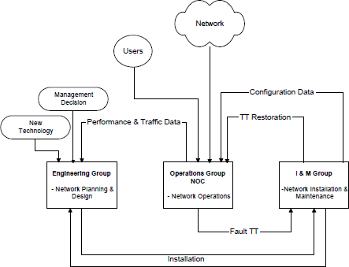
Telecomm Network Management
From a business adminstration point of view, network mangement involves strategic and tactical planning of engineering, operations, and maintenance of network and network services for current and future needs at minimum overall cost. There needs to be a well -established interaction between the various groups performing these functions.
Fig 1.2.1 presents a top down view of network management functions. It comprises three major groups: I) network and service provisioning, II) network and service Oprerations, and III) network I & M.
Network provisioning is the primary responsibility of the Engineering group. The Customer Relation group.
The customer Relations group deals with clients and subscribers in providing services planned and designed by the Engineering group.
Network I &M is the primary responsibility of the Plant Facilities group.
Interaction between the groups are shown in Fig 1.2.2. Normal daily operations are the functions of the Network Operations group, which controls and administers a NOC. This is the nerve center of network management operations. The functions of NOC are primarily concerned with network operations, its secondary responsibilities are network provisioning and network I & M. The associated service operations are handled by a subscriber operation center (SOC) and customer relations mangement(CRM).
Figure 1.2.2 Network Management Functional Flow Chart

Slide 9
Telecomm Network Management
Network Provisioning
Network Provisioning consists of network planning and design and is the responsibility of the Engineering group. The Engineering group keeps track of new technologies and introduces them as needed. What is needed and when it is needed are determined from analysis of traffic and performance data provided by the network operations. New or modifications to network provisioning may also be initiated by management decisions. Planning and efficient use of equipment can be achieved with good inventory mangement of current and future modifications of network configuration by the Network provisioning group.
Network mangement tools are helpful to the Engineering group in gathering statistics and studying trends in traffic patterns for planning purposes. Automated operations systems help in the design of circuits and measuring the performance tune -up.
Network Operations and NOC
The functions of network operations listed in Figure 1.2.1 are administered by the NOC. They are concerned with daily operations of the network and providing network services. ISO has defined five OSI network management applications, which are fault, configuration, performance, security, and account management. They are also responsible for gathering statistics and generating reports for mangement, systems support, and users. NMS and tools are a necessity for NOC operations. They are used in various management applications described below.
Fault Management / Service Restoration
Whenever there is a service failure , it is NOC's responsibilty to restore service as soon as possible. This involves detection and isolation of the problem causing the failure, and restoration of service. In several failure situations, the network will do this automatically. This network feature is called self -healing. In other situations, NMS can detect failures of components and indicate with appropriate alarms. Restoration of service does not include fixing the cause of the problem. That responsibility usually rests with the I & M group. A trouble ticket is generated and followed up for restoration of the problem by the I &M group.
Trouble Ticket Administration
Trouble ticket adminstration is the administrative part of fault management and is used to track problems in the network. All problems, including non-problems, are to be tracked until resolved. Periodic analysis of the data, which are maintained in a database, is done to establish patterns of the problems for follow-up action. There are trouble- tracking systems to automatethe tracking of troubles from the automatic generation of a trouble ticket by a NMS to the resolution of the problem.
Configuration Management
There are three sets of configuration of the network. One is the static configurtion and other is the permanent configuration of the network. However, it is likely that the current running configuration, which is the second , could be different from that of the permanent configuration.

Slide 10
Telecomm Network Management
Static configuration is the one that the network would bring up if it is started from an idle status. The third configuration is the planned configuration of the future when the configuration data will change as the network is changed. This information is useful for planning and inventory mangement. The configuration data are automatically gathered as much as possible and are stored by NMSs. NOC has a display that reflects the dynamic configuration of the network and its status. The status of the network is displayed by a NMS and indicated any failures of components of the network, as well as the traffic pattern and performance. Any configuration changes needed to relieve temporary congestion in traffic are made by NOC and are reflected in the dynamic display at NOC.
Performance Management
Data need to be gathered by NOC and kept updated in a timely fashion in order to perform some of the above functions, as well as tune the network for optimum performance. This is part of performance management. Network statistics include data on traffic, network availability, and network delay. Traffic data can be captured based on volume of traffic in various segments of the network. They can also be obtained based on different applications such as Web traffic, email, and network news, or based on transport protocols at various layers such as TCP, UDP, IP, IPX, Ethernet, TR, FDDI, etc. Traffic statistics are helpful in detecting trends and planning future needs. Performance data on availability and delay are useful for tuning the netwotk to increase the reliability and to improve its response time.
Security Management
It can cover very broad range of security. It involves physically securing the network, as well as access to the network by users. Access privilege to application software is not the responsibility of NOC unless the application is either owened or mainained by NOC. A security database is established and maintained by NOC for access to the network and network inforation.
There are other aspects of security mangement such as firewalls and cryptograpy.
Accounting Management
It administers cost allocation of the usage of network. Metrices are established to measure the usage of resources and services provided.
1.2.4 Network Installation and Maintenance
The network I &M group takes care of all activities of installation and maintenance of equipment and transmission facilities. This group is the service arm of the Engineering group for installation and fixing troubles for network operations. The group works closely with the Help Desk in responding to the problems reported from the field.

Slide 11
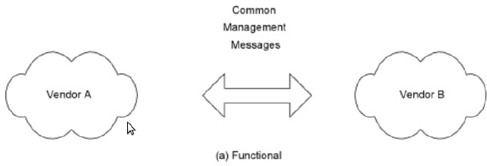
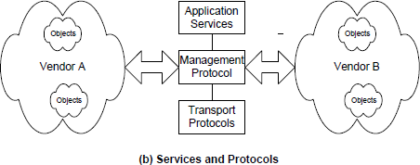
Telecomm Network Management
1.3 Network Management Architecture and Organization Network Management Perspectives
1.3.1 Network Management Architecture and Organization
Network management dumbell architecture for interoperability is shown in Figure 1.3.1(a) where two vendor systems A and B exchange common mangement messages. The messages consists of mangement information data(type, id, and status of managed objects, etc.) and management controls (setting and changing configuration of an object). The protocols and seervice associated with dumb bell architecture are presented in Figure 1.3.1 (b).
Figure 1.3.1 Network Management and Dumbell Architecture
Application services are the management-related applications such as fault and configuration mangement. Management protocols are CMIP for the OSI model and SNMP for the Internet model. Transport protocols are the first four OSI layers for the OSI model and TCP/IP over any of the first two layers for the Internet model.

Slide 12
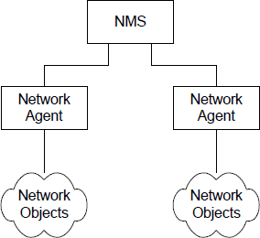
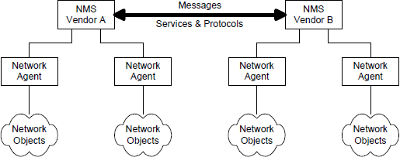
Telecomm Network Management
Figure 1.3.2 models a hierarchical configuration of two network agents monitoring two sets of manged objects. The agent could be an embedded agent in a network element or an EMS communicating with agents embedded in the network elements. An NMS is at the top of the hierarchy. Each network agent monitors its respective objects. Either in response to apolled query from the NMS or trigerred by a local alarm, the agent communicates to the NMS the relevant data.
Figure 1.3.2 Network Management Components
Peer networks can communicate network mangement messages and controls between each other, as shown in Figure 1.3.3. An example where such a configuration could be implemented would be two NMSs associated with two telecommunication networks belonging to two network service providers, for example an interexchange carrier and a local access provider. As the two NMSs communicate with each other, each NMS can superimpose the data from the other and present an integrated picture to the network administrator
Figure 1.3.3 Network Management Interoperability

Slide 13
Telecomm Network Management
1.3.2 Network Management Perspectives
The NMS primarily manges the networks that transport information. However, from a user's perspective, networks are means toan end, namely to have access to information across the networks. Thus, the user's needs require a total solution to manage the networks, system resources, and applications that run on systems. Applications could be specific user applications, or general- purpose servers such as file servers, database servers, and DNSs. Software products have since been developed to address such system wide solutions.
An IT manger is interested in more than managing networks, systems and applications. He or she would automate other functions such as back up od database and programs, downloading of software updates from a central location, and a host of other support functions. These are required to run an IT operation efficiently and in a cost effective manner.
Another area of system management is logging and archiving of events. This is illustrated by a case history when the system performance during normally slow activity time at night was poor. Further probing the system resources indicated that the system was busy with processes being executed from outside the institution. The system had been 'compromised” i.e, had been broken into. The intruder could manipulate the normal system reource tools so as to hide the intruder programs. The intruder was finally discovered from the archival system log.
1] Network Management Perspective
Domains : The network management can be perceived as management of domain. The domain canbe any of a selected group of parameters having common attributes. Thus , a gerographical domain refers to the subdivision of a large geographical region. For example, in India the telcommunication adminstration is divided into circles, and each circles maintains its own telecommunication network.
Another classification of a domain can be based on vendor products. Thus, we could have different vendors' management systems managing their respective products. A third perspective of looking at domains can be from the technology perspective. For example, IP based products, telcommunication products, broadband communication products, and digital transport products such as SDH could each define a domain managed by a separate NMS, as well as a different adminstrative group.
Protocols: Network management can be perceived from the protocol used to manage the network such as internet-based SNMP and OSI based Common Management Information Protocol/ Common Management Information Service Element (CMIP/CMISE). Traffic use of various protocols at each protocol layer can be mointored.
Network and Transmission Technologies: An end-to- end network system could be viewed as comprising multiple network technologies traversing different transmission media and carrying information in different transmission modes, each managed from a different network mangemnt perspective. Thus, an end- to end communication, which can be represented as a logical circuit, could be made up of network elements comprising IP -based routers and ATM -based switches. It can traverse globally through coaxial cable in an access network, wireless transmission over continents, fiber optic cable over land, on a WAN, and twisted copper wire at home.

Slide 14
Telecomm Network Management
The transmission mode could be digital TDM, or ATM, or a broadband access mode. An integrated NMS is used to manage end-to-end availability of a circuit taht deploys multivendor and multitechnology network elements.
Service Management Perspective
The network is to provide service to customers and consequently what needs to be managed are the services. The real concern of service providers is more about service management. Providing quality of service to satisfy the customer's needs requires network mangement. However, while network management focuses on the physical network, service management focuses on services offered over the network and those services meeting customer needs and satisfaction. Various quality of service (QoS) parameter are defined and an SLA is reached between the service provider and the customer. There are several OSSs that provide different types of service management.
Communication services can be offered as public switched network services, Internet services, virtual private network, real time inerative audio and video services, and others too numerous to list. Computing services are offered to clients using applications running on servers. These servers and applications running on them need to be managed centrally by the service provider or enterprise that owns them. This management is also known as enterprise mangement. It monitors the health of system resources, as well as the applications that run on them. Thee are managed service offerings available to manage multiple enterprise networks from a common mangement facility.
OSS Perspective
OSSs support the operation of network and service management systems.
Provisioning System: The logical and physical network has to be provisioned to provide the desired service to the suctomer. An OSS, provisioning management system, does this function using several other OSss such as inventory management system, the service order system, and the element and NMSs. Provisioning management includes circuits provisioning, service provisioning and network provisioning.
Inventory Nanagement System : It includes inventory of equipment and facilities. We can generalize equipment as active components forming nodes of a network and facilities as passive components linking the nodes.
Customer Relations Management (CRM) operation support system manages complaints reported by the customers. A proactive approach to CRM is the service provider calling the customer on detecting a service outage indicated by NMS.
Trouble Ticket and Work Force Management: It manages the troubles detected by the NMS and generates work order in the Work Force Management Systems. Various OSSs help with the remote testing, either on -demand or automated, in installation and maintenance.
IP Telecommunication Application Management : The traditional analog services of voice and video are now offered as digital services. Such services as voice- over- IP and video- over- IP applications require not only management of data, but also connection management. Sessions that
are equivalent to a circuit need to be extablished and managed.

